Slide 1
Botnet Detection with Ensemble Machine Learning Method
Internship Progress Report
Thanawat Tejapijaya
10/7/2023

Slide 2
Content
Background
Dataset Analysis
What Have I tried
Research Proposal
Objective
Methodology
Experience
Future Work

Slide 3
Background

Slide 4
Reason Why I came here
to gain research experiences
to work on Senior Project which is Machine Learning Based Adaptive Cybersecurity incident detection

Slide 5
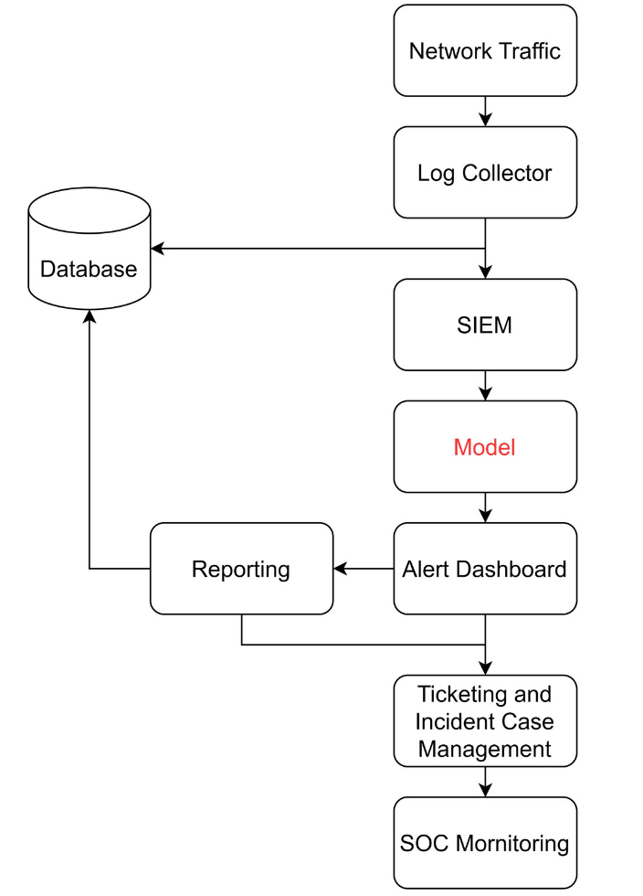
Machine Learning Based Adaptive Cybersecurity incident detection
Security Information and Event Management (SIEM) is system that help soc team organize, detect and responds to security threat
Model is Machine Learning model

Slide 6
My Interest
Botnet

Slide 7
What is botnet
Botnet is a network of computer that get infected by malware and under control of a single attack party without owner’s knowledge.
The word botnet came from robot and network
Life Cycle of Botnet
Injection
Command & Control Server
Upgrading & Maintenance
Maintain active botnet and spreading new botnet
Inject malware to the network
Download script and active the botnets

Slide 8
Why botnet?
Some botnet can be easily to detect by SIEM or with our eyes BUT most of it evolved and adapted their behavior to bypass SIEM
Especially, Legacy System such as insecure IoT device, Bank, Hospital etc.

Slide 9
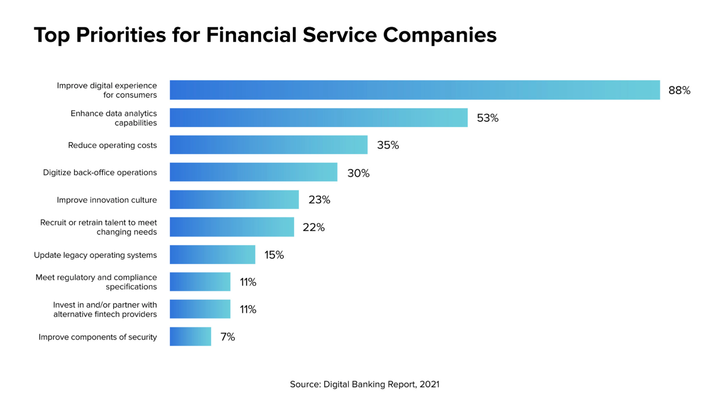
Picture from https://www.mx.com/blog/digital-experience-banks-top-priority/

Slide 10
Why botnet? (2)
History of botnet attack
Mirai Botnet 2016 – First botnet attack to target IoT device, infected over 600k insecure IoT device, Still mutating!
3ve 2018 – evaded detection and first detected by HUMAN, infected over 700k PC, compromised over 1 million ip addresses
As Botnet attack has become very challenge to detect such as 3ve due to it’s fast, massive and can evolve from time to time, that is why we need Machine Learning to help detect it due to Machine Learning is fast and have a chance to detect it before it’s too late.
https://lunio.ai/blog/ad-fraud/3ve-botnet/ https://www.humansecurity.com/learn/blog/9-of-the-most-notable-botnets

Slide 11
Dataset Analysis

Slide 12
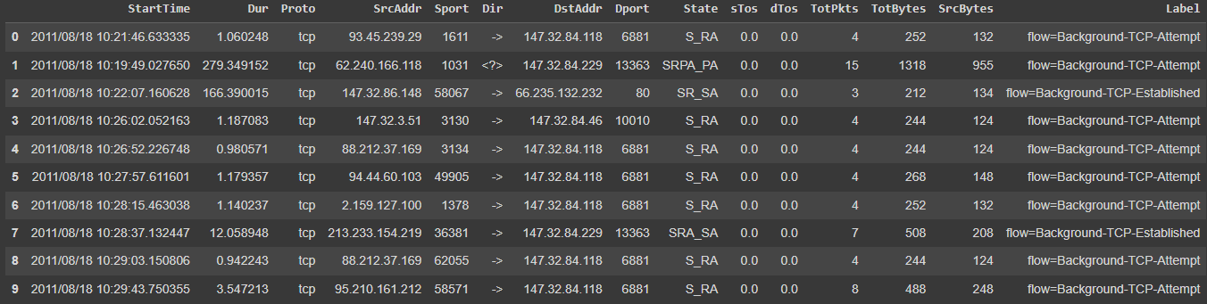
CTU 13 Dataset
Dataset that capture network traffic of Botnet
Contain 13 files each files is independent from each others due to different behaviors of Botnet
15 Features
7 Categorical Features
7 Numerical Features
1 label

Slide 13
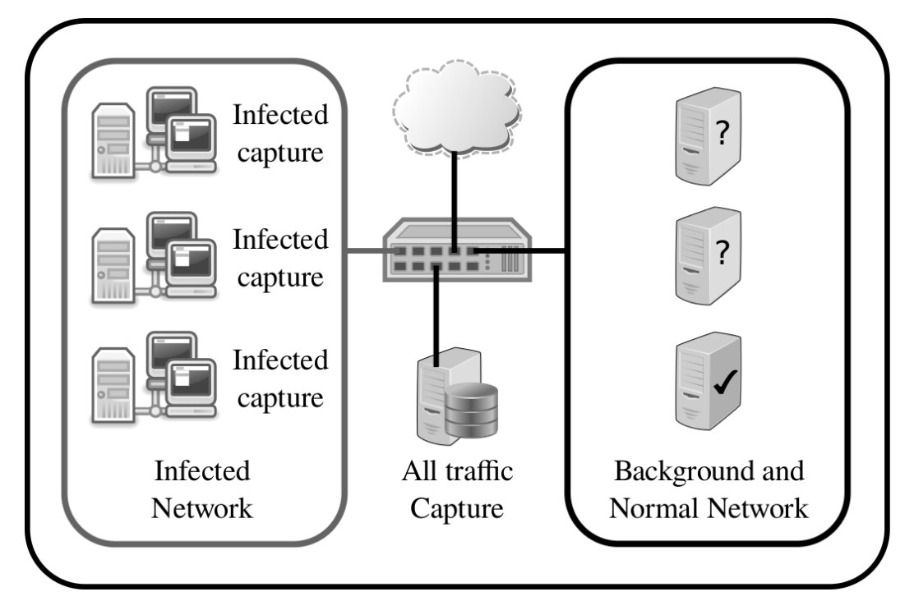
How was the dataset created?
It’s a Simulated dataset
Infected Network consist of Virtual Machine (VM) that running Window XP SP 2 operation System
Capture Network Traffic from both Infected Network and Router
picture are from "An empirical comparison of botnet detection methods" Sebastian Garcia, Martin Grill, Jan Stiborek and Alejandro Zunino. Computers and Security Journal, Elsevier. 2014. Vol 45, pp 100-123. http://dx.doi.org/10.1016/j.cose.2014.05.011

Slide 14
How it’s labeled?
Final dataset is from Router
Captured by tcpdump tool
Use data that was captured from Infected Network for labeling purpose
Step of Labeling
Assign all traffic to be Background
Assign it Normal if they match certain filter
Assign Botnet if they are known or from infected host by looking at the ip address
* The dataset creator already know the answer

Slide 15
Definition
Abnormal Flows mean Every Botnet Attack Flows
Normal Flows mean Every Flows that isn’t botnet

Slide 16
What have I tried

Slide 17
Data preprocessing

Slide 18
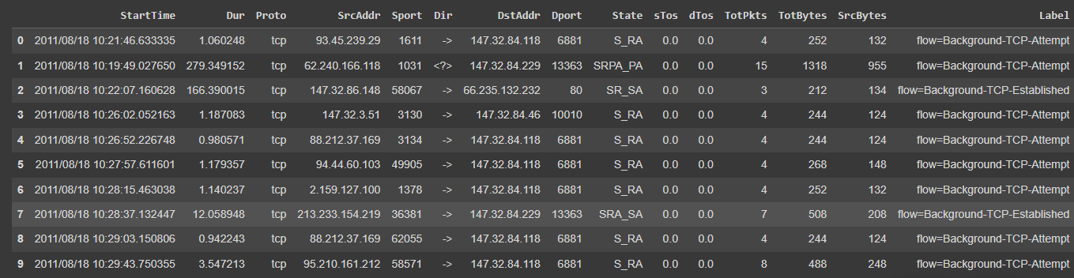
Data Preprocessing
Window width 120 seconds and slide 60 seconds^{2,3}
One window (width = 120 seconds)

Slide 19
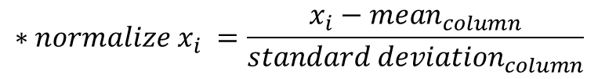
Data Preprocessing(2)
$$∗{normalize x}_{i} =\frac{x_{i}−{mean}_{column}}{{standard deviation}_{column}}$$
Feature dropped
sTos, dTos, Dir, Proto, State, TotPkts
Feature Extraction
Categorical Feature – group by source address
number of unique occurrence in subgroup and normalize*
Normalize subgroup after using Shannon Entropy¹
dropped

Slide 20
Data Preprocessing(3)
$$∗{normalize x}_{i} =\frac{x_{i}−{mean}_{column}}{{standard deviation}_{column}}$$
Numerical Feature
Sum, mean, standard deviation, maximum and median and normalize*
As a result, from 15 features dropped 5 and extracted into 22 features

Slide 21
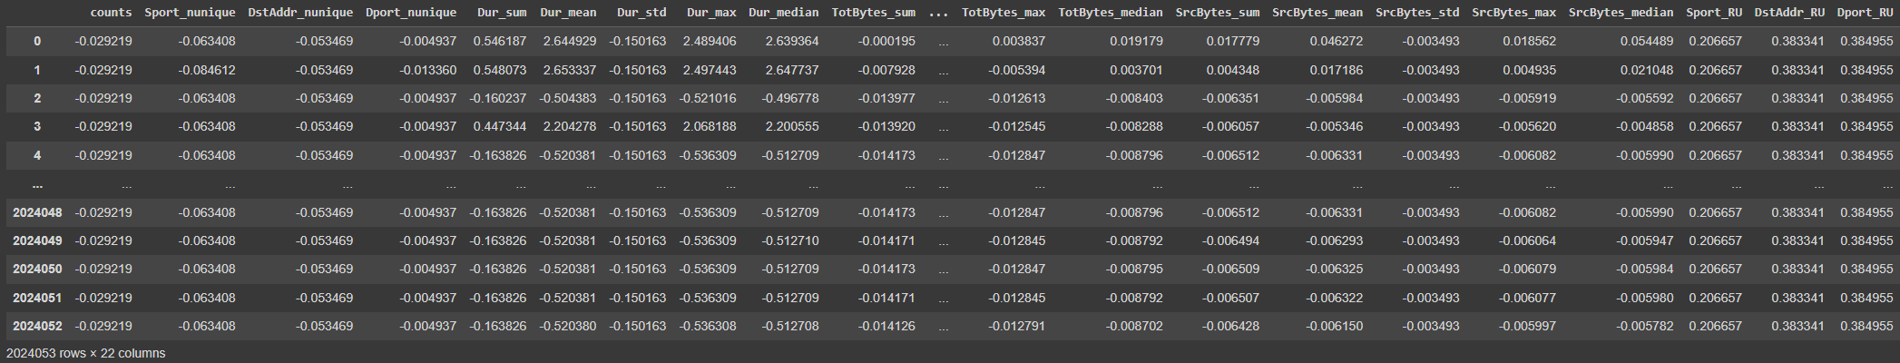
Feature After Extract (22 features)
Normalize Entropy of each column
Number of unique occurrence in subgroup

Slide 22
Training Model
Random Train and Test 13 files separately 50 times
4 Models
Logistic Regression Ridge
Random Forest
Support Vector Machine (SVM)
Long Short Term Memory (LSTM)

Slide 23
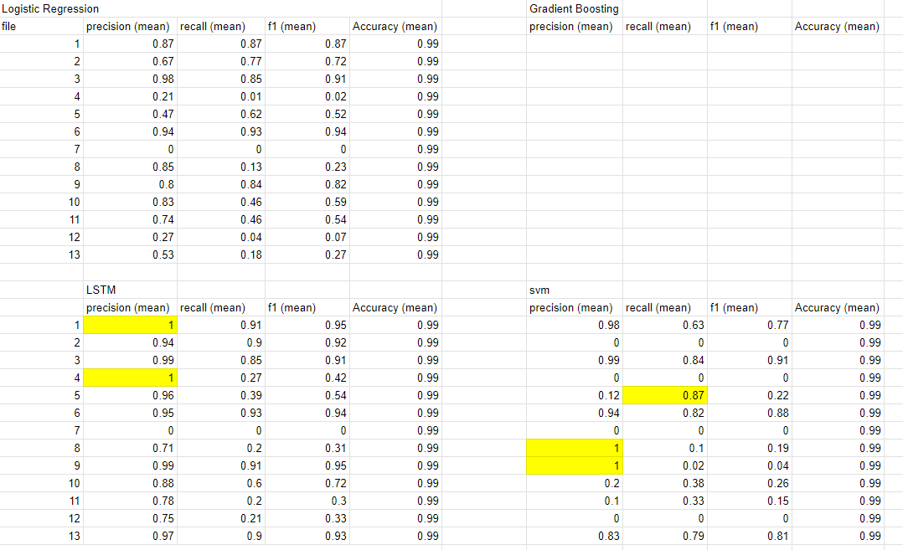
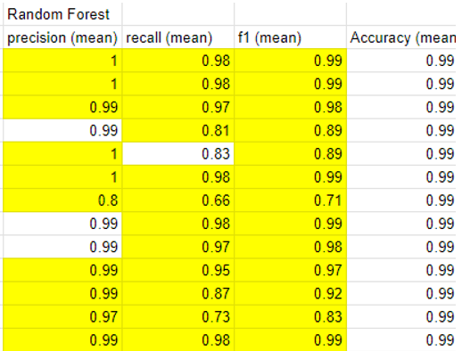
Result (Test Separately)

Slide 24
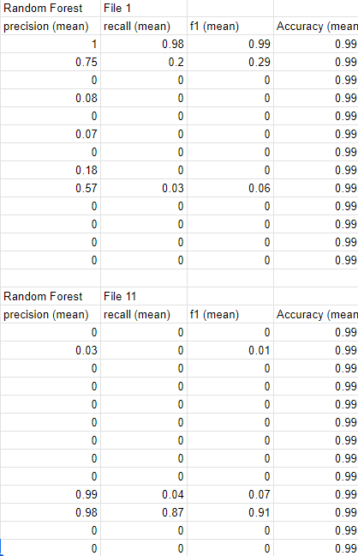
Result(When use one dataset to train and test with others)

Slide 25
Research Proposal

Slide 26
Botnet Detection with Ensemble Machine Learning Method

Slide 27
Research Objective
Find a robust model for detecting botnet

Slide 28
Methodology
Logistic Regression
SVM
Gradient Boosting
Random Forest
LSTM
dataset
Data Preprocessing
Train & Test each file separately
CTU 13 dataset
Shannon Entropy
one hot encoder
Ensemble technique
Bagging
Boosting
Stacking
Evaluation
F1 score, precision , recall

Slide 29
What have I gain so far?
Experiences of working as a researcher
How to Analyze dataset
Learn about Machine learning
Soft Skill
Communication
Language
Time Management
Critical Thinking

Slide 30
Future Work
Continue writing research proposal
Data preprocessing

Slide 31
Thank you

